Slide 1

PROJECT PRESENTATION
Clone Of Adidas Website
Presentation By- Team No. 28

Slide 2

1 Team
Members
3 Our
Solution
5 Challenges
Faced
2 Problem
Statement
4 Working
Demo
6 Learning’s By
Project

Slide 3
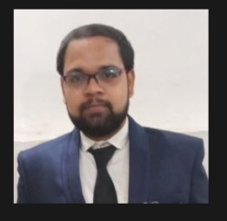

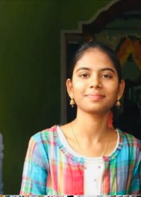
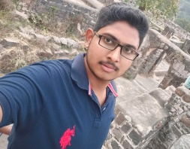
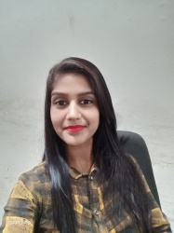
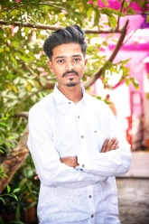
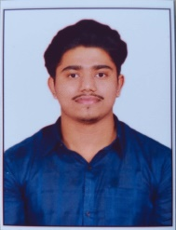
Rohit Kumar Sahu
Bhavani Dasari
Yadulla Malik Shaik
Radhika Gupta
Swaraj Nikam
Akash Borate

Slide 4

Problem Statement
We were given the task
to clone Adidas
website and replicate
the product buying
process.

Slide 5

Our Solution
We have created a clone of Adidas using HTML CSS and JS and we have tried to replicate the shoes buying process of Adidas website (modify accordingly )

Slide 6

Working Demo
Add link here

Slide 7

Challenges Faced

Slide 8

Learning's From Project

